Slide 1
The Relationship between Cryptocurrency and Energy Prices?
An Exploratory Analysis
Shermeen Ajani
Stuart Manito Smith
Timothy Smith
10-30-21

Slide 2
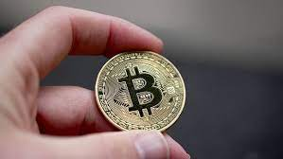
Crypto
Bitcoin
How is it made?
Enormous amount of power

Slide 3

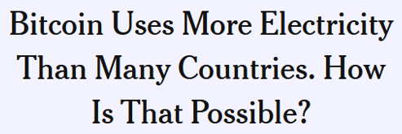
Energy Consumption
https://www.nytimes.com/interactive/2021/09/03/climate/bitcoin-carbon-footprint-electricity.html

Slide 4
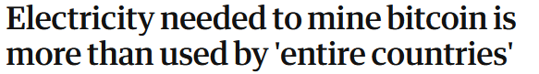
Energy Consumption
https://www.theguardian.com/technology/2021/feb/27/bitcoin-mining-electricity-use-environmental-impact

Slide 5
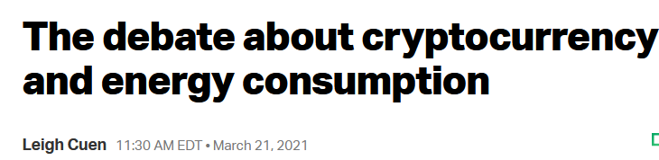
Energy Consumption
https://techcrunch.com/2021/03/21/the-debate-about-cryptocurrency-and-energy-consumption/

Slide 6
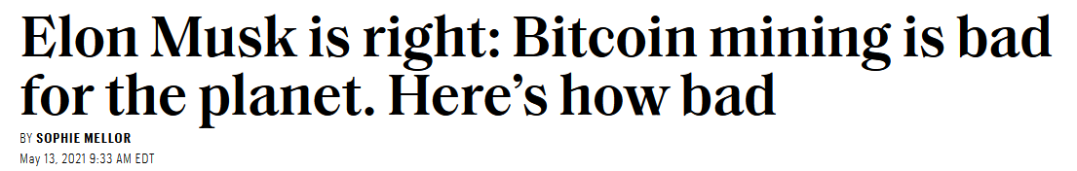
Energy Consumption
https://fortune.com/2021/05/13/musk-bitcoin-mining-bad-planet-heres-how-bad/

Slide 7

Energy Consumption
https://www.independent.co.uk/climate-change/news/bitcoin-mine-nft-oil-well-viral-b1816478.html

Slide 8
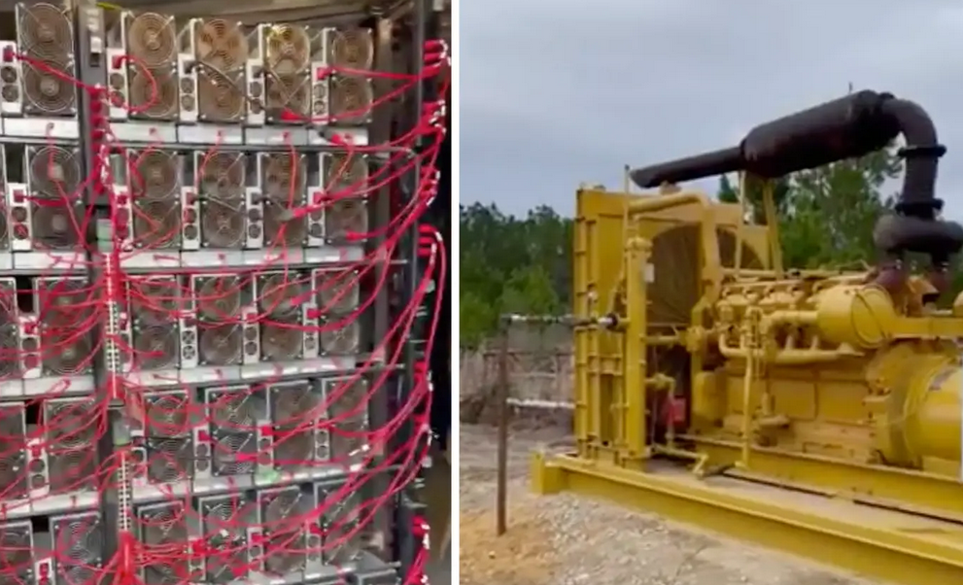
Energy Consumption

Slide 9
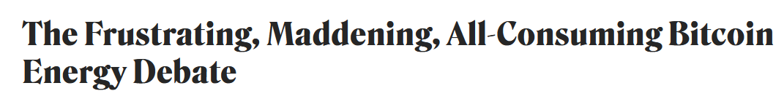
Energy Consumption
https://www.coindesk.com/business/2021/03/05/the-frustrating-maddening-all-consuming-bitcoin-energy-debate/

